Slide 1


BHARGAVI
Team Members: Indrashis Ghosh (CSE 4th year)
12100119060
Sourasish Ghosh (CSE 4th year)
12100119055
Shuvra Das (CSE 4th year)
12100119040
Debolina Bhattacharjee (CSE 4th Year)
12100119048

Slide 2
Project Idea:
We have decided to make a robot that can detect pests and specific diseases for crops and plants.
Thereafter it will suggest pesticides to prevent that disease.

Slide 3
Key Features/Objectives:
Our robot will be rolled throughout the crop field and it will detect/identify the pest.
Then it will suggest some pesticides which can prevent that crop from that identified pest.
Also, we have planned to create a system through which respective pesticides will be sprayed automatically on crop.

Slide 4
Robotics Applied In^{[1]}:
Weed Control
Weed Mapping
Apply Fertilizer
Micro & Macro Spray
Robotic Irrigation
Selective Harvester

Slide 5
Early Detection and Classification, Sreelakshmi M et. al ^{[2]}:
Extracted features like Mean, Standard deviation, Contrast, Energy, Filled area.
Support Vector Machine (SVM) has been used for pest detection and classification.

Slide 6
Insect Classification and Detection, Thenmozhi Kasinathan et. al ^{[3]}:
Used Wang and Xie dataset.
Used nine shape features including area, perimeter, major axis length, minor axis length, eccentricity, circularity, solidity, form factor and compactness.
They applied ANN, KNN, CNN, SVM and NB classifier.
Highest accuracy 93.9% achieved using CNN classifier.

Slide 7
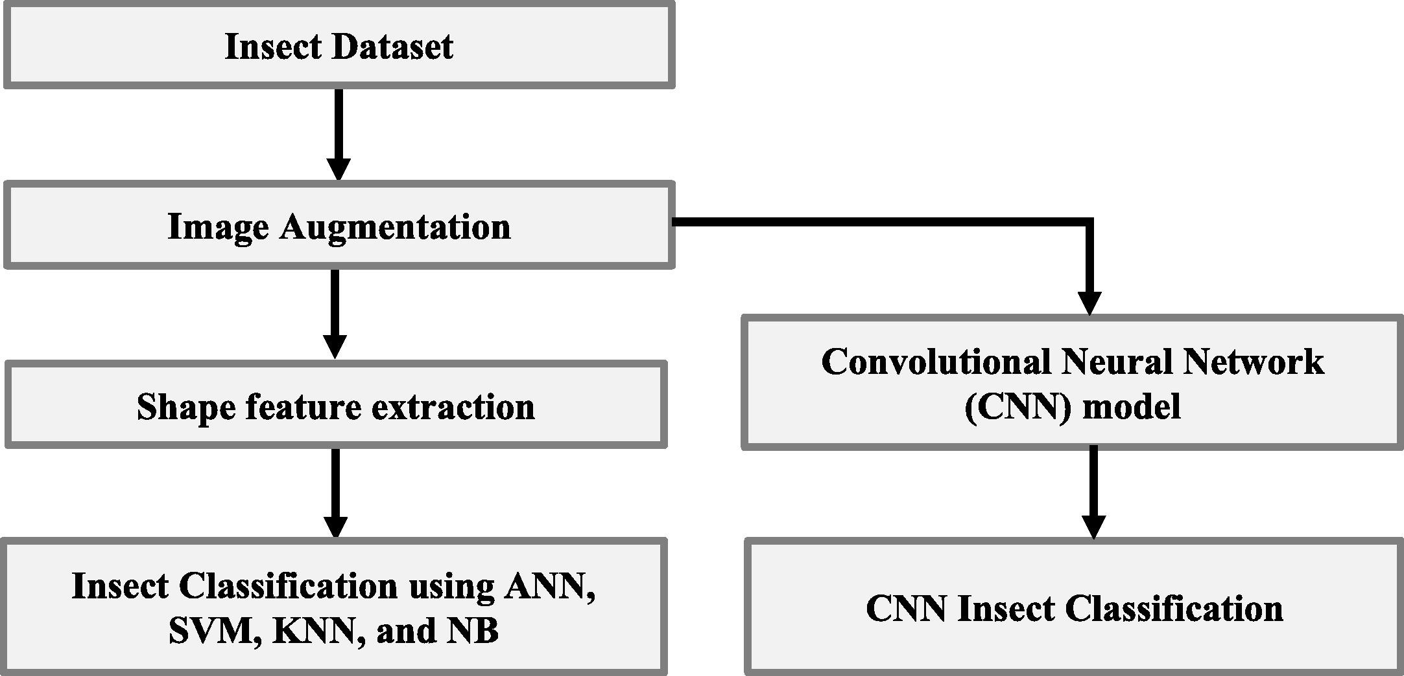
Framework for insect classification

Slide 8
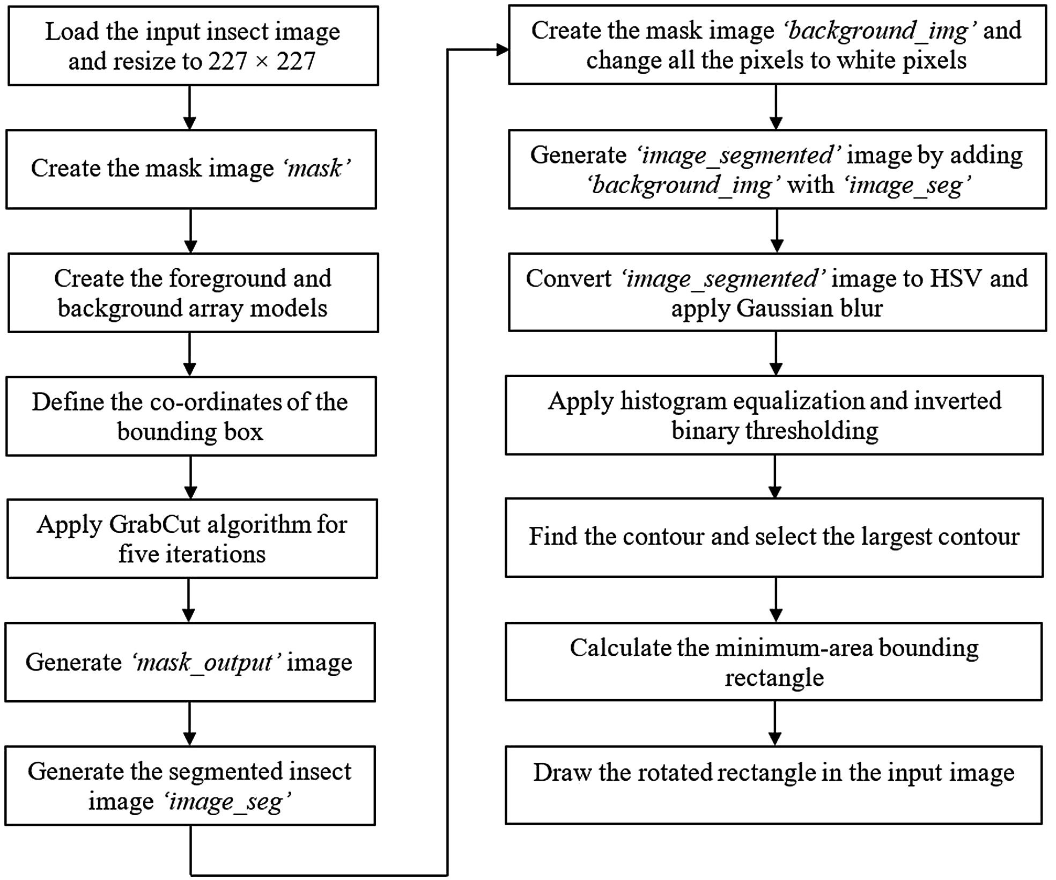
The flow chart of insect pest detection algorithm

Slide 9
References:
1. AHMED Hassan, JURAIMI Abdul Shukor, MUHAMMAD HAMDANI Saiful, Introduction to Robotics Agriculture in Pest Control: A Review, Pertanika Journal of Scholarly Research Reviews, 2(2): 80-93, PJSRR (2016).
2. Sreelakshmi M, Padmanayana, Early Detection and Classification of Pests Using Image Processing, INTERNATIONAL JOURNAL OF INNOVATIVE RESEARCH IN ELECTRICAL, ELECTRONICS, INSTRUMENTATION AND CONTROL ENGINEERING, Vol. 3, Special Issue, 1, April 2015.
3. Thenmozhi Kasinathan, Dakshayani Singaraju, Srinivasulu Reddy Uyyala , Insect classification and detection in field crops using modern machine learning techniques, information-processing agriculture, Pages 446-457, 3 September 2021.

Slide 10
Dataset
Name:
IP102_v1.1
Link:
https://drive.google.com/drive/folders/1svFSy2Da3cVMvekBwe13mzyx38XZ9xWo

